Slide 1
十二、Nonparametric Methods
(Chapter 12)
劉仁沛教授
國立台灣大學農藝學研究所生物統計組
國立台灣大學流行病學與預防醫學研究所
國家衛生研究院生物統計與生物資訊組
jpliu@ntu.edu.tw
【本著作除另有註明，網站之內容皆採用 創用CC 姓名標示-非商業使用-相同方式分享 3.0 台灣 授權條款釋出】

Slide 2
Learning Objectives
Learn advantages and disadvantages of nonparametric statistics.
Nonparametric tests:
  Testing randomness of a single sample: Run test
  Testing difference
    Two independent samples: Mann-Whitney-Wilcoxon Rank Sum test
      Two-sample z/t test
    Two dependent samples. Wilcoxon signed rank test
      Paired sample t test
    >2 independent samples. Kruskal-Wallis test
      One-way ANOVA
    >2 samples with blocking: Friedman test
      RCBD
  Correlation: Spearman’s rank correlation coefficient
Notes:
2

Slide 3
Introduction
Assumption for t-test or correlation (regression) coefficients
  Normality
  Equal variance
  Independence
Not all data satisfy these assumptions!

Slide 4
Parametric v.s. Nonparametric statistics
Parametric statistics mainly are based on assumptions about the population
  Ex. X has normal population for t-test, or ANOVA.
  Requires interval or ratio level data.
Nonparametric statistics depend on fewer assumptions about the population and parameters.
  “distribution-free” statistics.
  Most analysis are based on rank.
  Valid for ordinal data.
Notes:
3

Slide 5
Advantages and Disadvantages of Nonparametric Techniques
Advantages
  There is no parametric alternative
  Nominal data or ordinal data are analyzed
  Less complicated computations for small sample size
  Exact method. Not approximation.
Disadvantages
  Less powerful if parametric tests are available.
  Not widely available and less well know
  For large samples, calculations can be tedious.
Notes:
4

Slide 6
Wilcoxon Signed-rank Test
Example:
脊柱後側凸病患，其平均Pimax值是否小於110 cm H₂O
  Ho：μ ≥ 110 vs. Ha： μ < 110
n=9
No power to verify the normality assumption

Slide 7
Wilcoxon Signed-rank Test
Exact Methods for Small Sample(n ≤ 30)
Calculate the difference X -110 for each of 9 observations. Differences equal to zero are eliminated, and the number of observations, n, is reduced accordingly.
Rank the absolute values of the differences, assigning 1 to the smallest, 2 to the second smallest, and so on. Tied observations are assigned the average of the rank that would have been assigned with no ties.

Slide 8
Wilcoxon Signed-rank Test
The indicator variable for sign is 1 if the difference is positive, is 0 if the difference is negative.
Multiple the sign and rank of absolute difference. This is called the signed rank.
Calculate the sum for the signed ranks, T_{SR}
For a two-tailed test, reject the null hypothesis if
T_{SR} > W_{1-α/2, n} or T_{SR} < W_{α/2, n}
Note: W_{α/2, n} = n(n+1)/2 - W_{1-α/2, n}

Slide 9
Wilcoxon Signed-rank Test
Methods for Larger Samples (n>30)
Test statistic:

Slide 10
Wilcoxon Signed-rank Test
Example: X=pi_{max}
Rank of sign*rank
X X-110 abs(X-110) abs(X-110) sign abs(X-110)
54.8 -55.2 55.2 3 0 0
62.0 -48.0 48.0 2 0 0
63.3 -46.7 46.7 1 0 0
44.2 -65.8 65.8 4 0 0
40.3 -69.7 69.7 5 0 0
36.3 -73.7 73.3 6 0 0
19.3 -90.7 90.7 9 0 0
24.6 -85.4 85.4 8 0 0
26.6 -83.4 83.4 7 0 0
Sum 0

Slide 11
Wilcoxon Signed-rank Test
N=9<30 ⇒ Exact Method
T_{SR} = 0
α=0.05, T_{0.025,9}=6 ⇒T_{SR} = 0 < T_{0.025,9}=6
Reject H₀ at the 0.05 level.

Slide 12
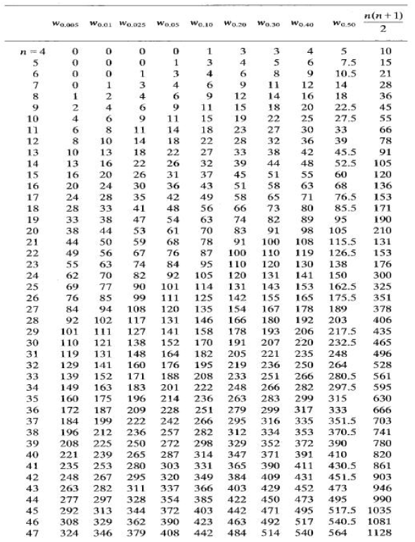
Quantiles of the Wilcoxon Signed Ranks Test Statistic

Slide 13
Mann-Whitney-Wilcoxon
Rank Sum Test
Two independent random samples
Example: Weight gain at one month by two baby formulas
A: 6.9, 7.6, 7.3, 7.6, 6.8, 7.2, 8.0, 5.5, 7.3
B: 6.4, 6.7, 5.4, 8.2, 5.3, 6.6, 5.8, 5.7 6.2, 7.1

Slide 14
Mann-Whitney-Wilcoxon
Rank Sum Test
Method
  Rank the observations in the combined sample from the smallest (1) to the largest (n1+n2)
  In case of ties, use the averaged rank
  Compute the sum of ranks for each sample

Slide 15
Mann-Whitney-Wilcoxon
Rank Sum Test
A B
Weight Rank Weight Rank
6.9 11 6.4 7
7.6 16.5 6.7 9
7.3 14.5 5.4 2
7.6 16.5 8.2 19
6.8 10 5.3 1
7.2 13 6.6 8
8.0 18 5.8 5
5.5 3 5.7 4
7.3 14.5 6.2 6
7.1 12
sum 117 73

Slide 16
Mann-Whitney-Wilcoxon
Rank Sum Test
Exact Method for Small Samples(n1+n2 ≤ 30)
Null hypothesis: H₀: The location of population distributions for 1 and 2 are identical.
Alternative hypothesis: H_{a}: The location of the population distributions are shifted in either directions(a two-tailed test).

Slide 17
Mann-Whitney-Wilcoxon
Rank Sum Test
Test statistics:
For a two-tailed test, use U,
where T₁ is the rank sums for samples 1.

Slide 18
Mann-Whitney-Wilcoxon
Rank Sum Test
Rejection rule:
For the two-tailed test and a given value of significance α, reject the null hypothesis of no difference if
U < w_{α/2,n1,n2} or
U > w_{1-α/2,n1,n2}
w_{1-α/2,n1,n2} =n₁n₂ - w_{α/2,n1,n2}

Slide 19
Mann-Whitney-Wilcoxon
Rank Sum Test
Method for larger Samples (n1+n2>30 )
Test Statistics:

Slide 20
Mann-Whitney-Wilcoxon
Rank Sum Test
Example:
reject H₀ that no difference exists between two baby formulas on weight gain

Slide 21
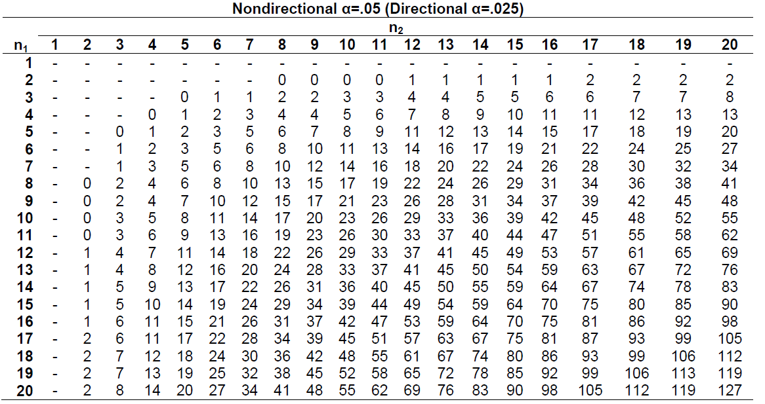
Critical Values for the Wilcoxon/Mann-Whitney Test (U)

Slide 22
Kruskal-Wallis Test
K independent samples
Example: body weights in gram of Wistar rats in a repeated dose toxicity study

Slide 23
Kruskal-Wallis Test
Data set: body weights in gram of Wistar rats in a repeated dose toxicity study
Control:
295.1 277.9 299.4 280.6 285.7 299.2 279.7 277.4 299.2 287.8 292.0 318.8 280.8 292.9 305.2
Low dose:
287.3 289.5 278.4 281.8 264.9 252.0 284.7 268.9 305.6 295.7 287.6 254.7 292.7 267.9 300.8
Middle dose:
247.5 281.1 284.5 295.0 285.9 273.7 244.1 272.7 262.1 278.8 298.3 298.5 293.5 259.6 275.3
High dose:
263.8 255.6 267.2 259.6 238.2 240.4 255.6 255.5 242.5 296.6 246.0 282.7 254.0 280.6 268.2

Slide 24
12.4 Kruskal-Wallis Test
Methods:
  Rank the combined sample from the smallest (1) to the largest(n₁+ n₂+… + n_{t} )
  In case of ties, use the averaged rank
  Compute the sums of ranks for each samples, R_{i}

Slide 25
12.4 Kruskal-Wallis Test
Methods:
Null hypothesis: H₀: The locations of the distributions of all of the k>2 populations are identical.
Alternative hypothesis: H_{a}: The locations of at least two of the k frequency distributions differ

Slide 26
12.4 Kruskal-Wallis Test
Test statistics:
Rejection region:
Reject H₀ if with (k-1) degrees of freedom

Slide 27
Kruskal-Wallis Test
Control:
295.1(49) 277.9(26) 299.4(56) 280.6(30.5) 285.7(38) 299.2(54.5)
279.7(29) 277.4(25) 299.2(54.5) 287.8(42) 292.0(44) 318.8(60) 280.8(32) 292.9(46) 305.2(58); sum = 644.5
Low dose:
287.3(40) 289.5(43) 278.4(27) 281.8(34) 264.9(17) 252.0(7) 284.7(37) 268.9(21) 305.6(59) 295.7(50) 287.6(41) 254.7(9) 292.7(45) 267.9(19) 300.8(57); sum = 506.5
Middle dose:
247.5(6) 281.1(33) 284.5(36) 295.0(48) 285.9(39) 273.7(23) 244.1(4) 272.7(22) 262.1(15) 278.8(28) 298.3(52) 298.5(53) 293.5(47) 259.6(13.5) 275.3(24); sum = 443.5
High dose:
263.8(16) 255.6(11.5) 267.2(18) 259.6(13.5) 238.2(1) 240.4(2) 255.6(11.5) 255.5(10) 242.5(3) 296.6(51) 246.0(5) 282.7(35) 254.0(8) 280.6(30.5) 268.2(20); sum = 236.0

Slide 28
12.4 Kruskal-Wallis Test
Example:
Reject H₀ that weights are the same for all groups

Slide 29
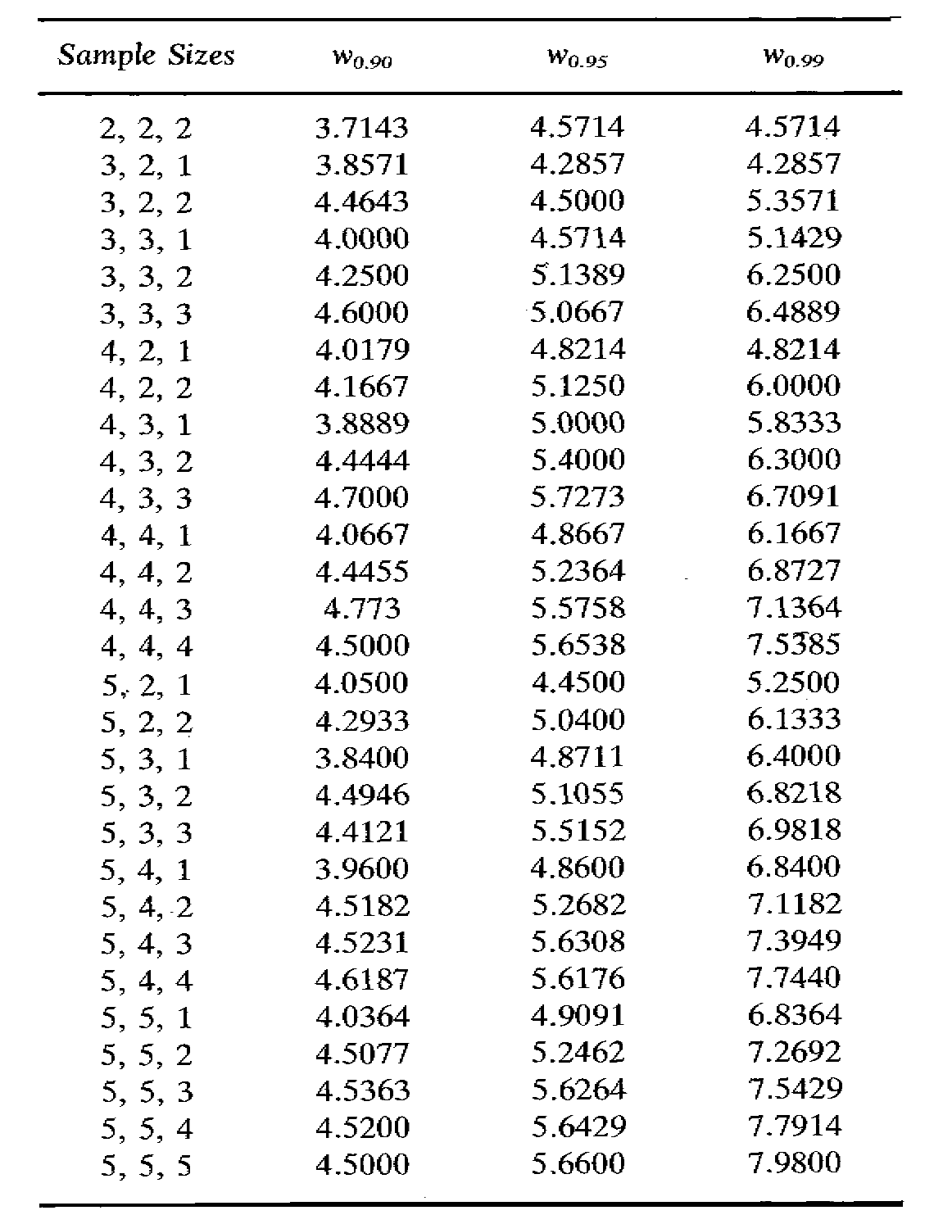
Quantiles of the Kruskal-Wallis Test Statistic for Small Sample Sizes

Slide 30
統計歷史人物小傳
Frank Wilcoxon (1892-1965)
PhD in organic chemistry from Cornell in 1924
Research in fungicide and insecticide from 1924-1943
  Boyce Thompson Institute for Plant Research
American Cyanamid from 1943-1957
More than 70 papers in plant physiology

Slide 31
統計歷史人物小傳
Frank Wilcoxon (1892-1965)
Apply statistical methods such as t test to plant pathology and discovered they are inadequate.
He developed the methods based on ranks
He did not know whether the method is correct or not.
He sent a manuscript of 4 pages to Biometrics in 1945 to let the referees tell him whether the method is correct or not.
The rest is the history of an new era of nonparametric statistics.

Slide 32
Summary
Wilcoxon Signed-rank Test
Mann-Whitney-Wilcoxon Test
Kruskal-Wallis Test

