Slide 1
國家與社會發展 CH3.國家決策過程的理論與實際
李碧涵 lbh@ntu.edu.tw
國立臺灣大學國家發展研究所教授
本作品除另有標示外，一律採取「創用cc
姓名標示-非商業性-相同方式分享」釋出

Slide 2
國家決策過程的理論與實際
權力菁英論 Power Elite Thesis
多元論 Pluralism
非決策理論 Non-decision Making Thesis
統治階級論 Neo-Marxist Ruling Class Thesis
社會爭鬥論 Social Struggle Thesis

Slide 3
權力菁英論 Power Elite Thesis
Was proposed by C. Wright Mills (1956) in the book “The Power Elite”
The power elite are composed of
the Corporate Rich (大企業)
the Executive (行政官員)
the Military (軍方)

Slide 4
權力菁英論 Power Elite Thesis
The power elite organize themselves to form the “military-industrial complex (軍產複合體)”.
They control the national policy making process and make policy for all people
The rest people are just silent, powerless masses

Slide 5
多元論 Pluralism
Was proposed by R. Dahl (1961) in the book “Who Governs? Democracy and Power in an American City”
Interest groups (利益團體) influence state policy-making process by means of direct occupation of key positions or indirect lobbying
Power is plurally distributed to various interest groups according to specific issues (特定議題) for decision-making

Slide 6
多元論 Pluralism
The pluralist thesis was based on studies of those who controlled public offices historically in the city of New Haven
But Domhoff found out for nation-wide power structure there’s a governing class (治理階級) that rules the America

Slide 7
非決策理論 Non-decision Making Thesis
Was proposed by P. Bachrach and M. Baratz (1962) in the journal article “The Two Faces of Power” (APSR)
By utilizing the mobilization of bias (偏差的動員), any organization (like state) can process non-decision making (非決策) & preserve potential issues (潛在議題) via agenda making

Slide 8
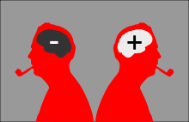
非決策理論 Non-decision Making Thesis
There exists the conflict of interests if grievances (抱怨) can be observed
Both pluralism and non-decision making thesis are behavioral-oriented (行為取向)

Slide 9
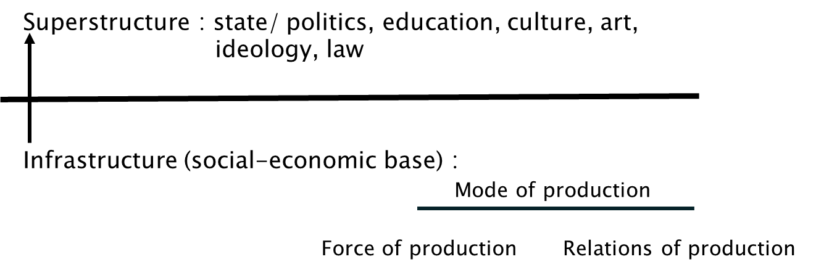
統治階級論 Neo-Marxist Ruling Class Thesis
Marx（1990 [1867]）的經濟決定論

Slide 10
統治階級論 Neo-Marxist Ruling Class Thesis
根據 Marx（1990 [1867]）的經濟決定論，誰掌握社會經濟底層結構（infrastructure或socio-economic base，是由生產方式mode of production之生產力與生產關係共同組成）
誰就掌控上層結構（superstructure）
故當然是資產階級/資本家掌控上層結構的一切，包括國家（state）、教育、文化、藝術、意識形態與法律等

Slide 11
統治階級論 Neo-Marxist Ruling Class Thesis
Was proposed by neo-Marxist R. Miliband (1969) in the book “The State in Capitalist Society”
The capitalist class (資本階級) controls the socio-economic base of capitalist society, and hence controls the state (控制國家) , and becomes the ruling class (成為統治階級)

Slide 12
統治階級論 Neo-Marxist Ruling Class Thesis
The capitalist class’ direct and indirect controls over the state
The state is just the instrument of the capitalist class (資本家的工具)
The state makes policies mainly for interests of the capitalist class

Slide 13
社會爭鬥論 Social Struggle Thesis
Was proposed by F. Block (1977) in the journal article “The Ruling Class Does Not Rule: Notes on the Marxist Theory of the State”
To study state structure (國家結構): The capitalist class is not interested to rule the state. It’s state managers that really rule

Slide 14
社會爭鬥論 Social Struggle Thesis
State managers (國家管理者) operate within the structural relationships of the capital, social groupings and the state itself
State policies and actions are to fulfill economic accumulation (合理的經濟積累) and political legitimacy (政治合法性)

Slide 15
綜合評論上述五個國家決策理論
權力菁英論
國家決策握在一小群權力菁英手裡
多元論
例如：各國軍需工業的發展
國家決策受制於各種利益團體，國家只是扮演仲裁者角色
例如：師資培育法制定，當時反對團體主要是師大系統，而贊成者如 人本教育基金會和非師大系統的各大學

Slide 16
綜合評論上述五個國家決策理論
非決策論
國家組織會透過偏差的動員，使一些議題不進入公開的決策過程，國家以政策宣示的方式使這些議題成為非決策
統治階級論
資本家力量強大，而掌控國家決策
例如：核四的興建或停建，都是以非決策形式出現
例如：美國，大藥廠、大型醫療組織、健康保險公司、醫師公會和藥師公會等掌控國會山莊制定醫藥法令與政策，這些組織每年花費數百億美元在國會山莊做遊說的工作

Slide 17
綜合評論上述五個國家決策理論
社會爭鬥論
國家決策權取決於資本家、社會群體和國家本身三者間之關係，State managers (國家管理者)掌控國家組織，以達成經濟積累和政治合法性
例如：各國都會制定有利於資本家的政策，包括減稅、免稅和獎勵投資等，但也要有社會福利政策，補助貧窮、失業和弱勢族群，以合理化資本主義社會的矛盾
各國制度安排各有不同，在國家介入與自由市場的光譜之間取得平衡。如北歐每個公民從小到博士畢業都享有完全免費的教育機會

Slide 18
National Policy-making in Practice
臺灣勞動基準法 (Labor Standards Act) 立法過程
前立法委員謝深山在立法院提出勞動基準法草案。
第一次石油危機 (oil crisis) 引發經濟嚴重衰退，此法案遭擱置。
第二次石油危機，歐美失業率上升
1972年
1973年
1978-79年

Slide 19
National Policy-making in Practice
臺灣勞動基準法 (Labor Standards Act) 立法過程
臺灣社會運動興起，包括勞工運動。透過多次中美經貿諮商談判，美國要求臺灣開放國內市場與服務業投資機會，並要求保障勞工權益
立法院審議通過勞動基準法，並開始實施。製造業納入勞基法適用範圍，包括規範工資、工時等工作條件以及加班費。但勞資雙方均極度不滿，都認為政府偏袒對方。
新自由主義 (neo-liberalism) 和 經濟全球化盛行，各國解除管制，採行經濟自由化和彈性勞動市場政策。以高科技與網路經濟為主的知識經濟快速發展，強調知識與資訊對經濟的重要性。
1980年
1984年
1990年

Slide 20
National Policy-making in Practice
臺灣勞動基準法 (Labor Standards Act) 立法過程
勞基法在勞資雙方要求下，在立法院第一次修正。因應勞方團體要求，服務業納入勞基法的適用範圍，國家藉此維持其統治正當性。但另一方面因應資方要求，實施四週彈性工時，以減少雇用成本，增加企業獲利，國家也藉此維持經濟積累
發生亞洲金融危機，2000年出現第一次全球經濟同步不景氣。2001年經歷網路經濟泡沫化
立法院勞基法修正為經工會或勞資會議通過，企業可實行八週或一年彈性工時
1996年
1997年
2001年

Slide 21
National Policy-making in Practice
臺灣勞動基準法 (Labor Standards Act) 立法過程
制定「大量解僱勞工保護法」，合理化資方的關廠或歇業，讓資方彈性運用勞動力
實施勞工退休金新制(勞退新制)，勞工在不同工作場所的工作年資可累計，成為可攜式帳戶(portable account)
2003年
2005年

Slide 22
討論
Q1:誰是台灣的統治階級?
Q2:上述哪個理論較適合分析台灣的政治權力和國家決策呢?

Slide 23
Thank you for your attention
台灣藍鵲

Slide 24
版權聲明
頁碼 | 作品 | 版權標章 | 來源/作者
3 | The power elite are composed …Military (軍方) |  | This work originally comes from The Power Elite, C. Wright Mills, Oxford University Press, 1956, P.161-164. and it is used/modified and subject to the fair use in accordance with Taiwan Copyright Act Articles 46 & 52 & 65 2016/10/20 visited
4 | The power elite…power less masses |  | This work originally comes from The Power Elite, C. Wright Mills, Oxford University Press, 1956 P.161-164. and it is used/modified and subject to the fair use in accordance with Taiwan Copyright Act Articles 46 & 52 & 65 2016/10/20 visited
5 | Interest groups influence… for decision-making |  | This work originally comes from Who governs? Democracy and power in an American city. By Robert A. Dahl. Yale University Press, New Haven, Connecticut, 1961, P.2-4 and used/modified subject to the fair use doctrine in accordance with: Taiwan Copyright Act Articles 46 & 52 & 65. "The Code of Best Practices in Fair Use for OpenCourseWare 2009 " by A Committee of Practitioners of OpenCourseWare in the U.S. The contents are based on Section 107 of the 1976 U.S. Copyright Act 2016/10/20 visited

Slide 25
版權聲明
頁碼 | 作品 | 版權標章 | 來源/作者
6 | The pluralist thesis…that rules the America |  | This work originally comes from Who governs? Democracy and power in an American city. By Robert A. Dahl. Yale University Press, New Haven, Connecticut, 1961, p2-4 and used/modified subject to the fair use doctrine in accordance with: Taiwan Copyright Act Articles 46 & 52 & 65. "The Code of Best Practices in Fair Use for OpenCourseWare 2009 " by A Committee of Practitioners of OpenCourseWare in the U.S. The contents are based on Section 107 of the 1976 U.S. Copyright Act 2016/10/20 visited
6 |  |  | Pixabay OpenClipart-Vectors https://pixabay.com/en/fist-hand-worker-class-working-162131/ 2016/10/22 visted
7-8 | By utilizing the mobilization of bias … behavioral-oriented (行為取向) |  | This work originally comes from Bachrach, P. and Baratz, M. (1962), 'The two faces of power', The Americun Political Science Review, Volume 56, Issue 4, P948-952 . and used/modified subject to the fair use doctrine in accordance with: Taiwan Copyright Act Articles 46 & 52 & 65. "The Code of Best Practices in Fair Use for OpenCourseWare 2009 " by A Committee of Practitioners of OpenCourseWare in the U.S. The contents are based on Section 107 of the 1976 U.S. Copyright Act 2016/10/20 visited

Slide 26
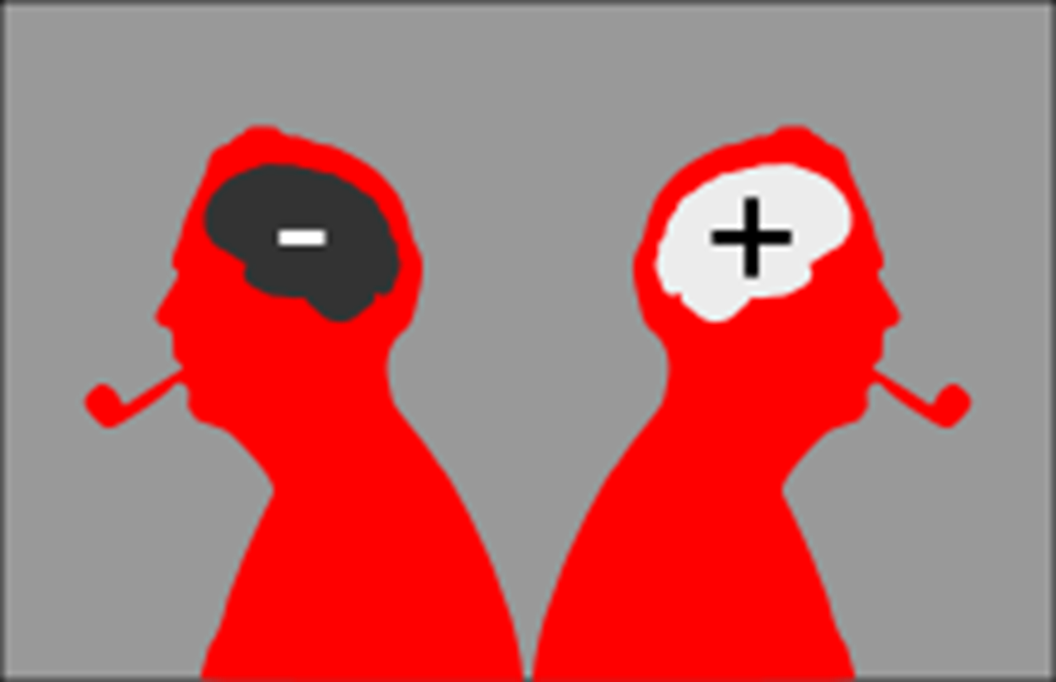
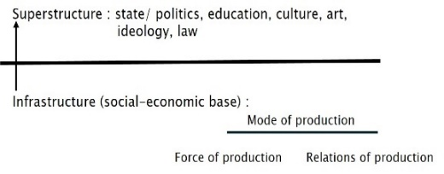
版權聲明
頁碼 | 作品 | 版權標章 | 來源/作者
8 |  |  | Wikimedia commons Nevit Dilmen https://commons.wikimedia.org/wiki/File:Mr_Pipo_Contraries.svg 2016/10/22 visted
9 |  |  | 臺灣大學 李碧涵
10 | 誰掌握社會經濟底層結構…意識形態與法律等 |  | This work originally comes from Karl Marx (1990 [1867]) , London, Capital Volume 1, P1-10 and it is used/modified and subject to the fair use in accordance with Taiwan Copyright Act Articles 46 & 52 & 65 2016/10/20 visited
11-12 | The capitalist class…interests of the capitalist class |  | This work originally comes from R. Miliband, “The State in Capitalist Society”, London, 1969 , P20-24 &P147-148. and used/modified subject to the fair use doctrine in accordance with: Taiwan Copyright Act Articles 46 & 52 & 65. "The Code of Best Practices in Fair Use for OpenCourseWare 2009 " by A Committee of Practitioners of OpenCourseWare in the U.S. The contents are based on Section 107 of the 1976 U.S. Copyright Act. 2016/10/20 visited

Slide 27
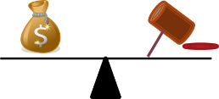
版權聲明
頁碼 | 作品 | 版權標章 | 來源/作者
13-14 | To study state structure…political legitimacy (政治合法性) |  | This work originally comes from F. Block (1977) in the journal article “The Ruling Class Does Not Rule: Notes on the Marxist Theory of the State, revising state theory, temple university press, Philadelphia , P52-57 and used/modified subject to the fair use doctrine in accordance with: Taiwan Copyright Act Articles 46 & 52 & 65. "The Code of Best Practices in Fair Use for OpenCourseWare 2009 " by A Committee of Practitioners of OpenCourseWare in the U.S. The contents are based on Section 107 of the 1976 U.S. Copyright Act 2016/10/20 visited
14-1 |  |  | pixabay OpenClipart-Vectors https://pixabay.com/en/bag-money-wealth-revenue-finance-147782/ 2016/10/22 visited
14-2 |  |  | 臺灣大學 李碧涵

Slide 28
版權聲明
頁碼 | 作品 | 版權標章 | 來源/作者
18-21 | 臺灣勞動基準法 (Labor Standards Act) 立法過程 ….可攜式帳戶 |  | 臺灣大學機構典藏 臺灣大學國家發展研究所 李碧涵 <全球化與勞動體制的新發展>， 2001年，頁12-14。 http://ntur.lib.ntu.edu.tw/handle/246246/147866#.WEoKK-Z942w 2016/10/22 visited
22 |  |  | Flickr Fred Seibert https://flic.kr/p/4eCRRZ 2016/10/22 visted
23 |  |  | Flickr Lai Walgtail https://flic.kr/p/F48uf 2016/10/22 visted

Slide 29
版權聲明
頁碼 | 作品 | 版權標章 | 來源/作者
1-29 |  |  | 本投影片範本及背景匯合來自Microsoft PowerPoint 2010 依據著作權法第46、52、65條合理使用本著作。

